Slide 1

Procurement under World Bank funded Projects
May 2015

Slide 2
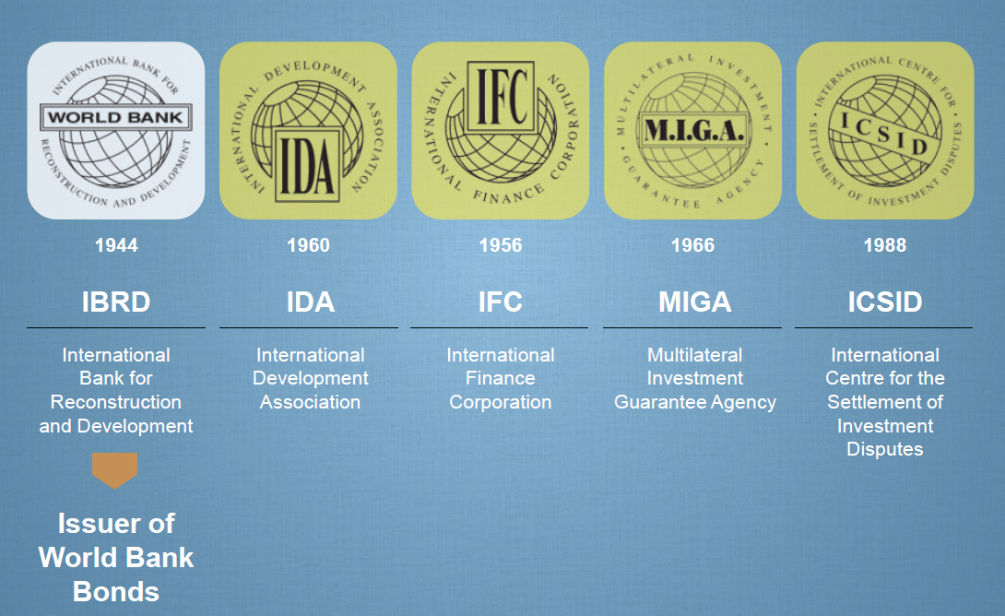
The “World Bank Group”
  Our Mission: End extreme poverty within a generation and boost shared prosperity.

Slide 3
IBRD and IDA
IBRD:
188 member countries
Reduce poverty in middle-income and creditworthy poorer countries
Banking products: loans, hedging products, guarantees.
Non-lending analytical and advisory services
IDA:
172 member countries
The world’s largest source of interest-free loans and grant assistance
Help the poorest countries

Slide 4
South Asia Region characterization
India
Pakistan
Afghanistan
Bhutan
Sri Lanka
Maldives
Bangladesh
Nepal
217 active projects
Portfolio value USD 38 BB
AFR | 24.7% [ 41,488.2]
EAP | 17.4% [ 29,141.1]
ECA | 13.2% [ 22,215.3]
LCR | 16.7% [ 28,104.5]
MNA | 5.2% [ 8,701.1]
SAR | 22.8% [ 38,206.0]

Slide 5
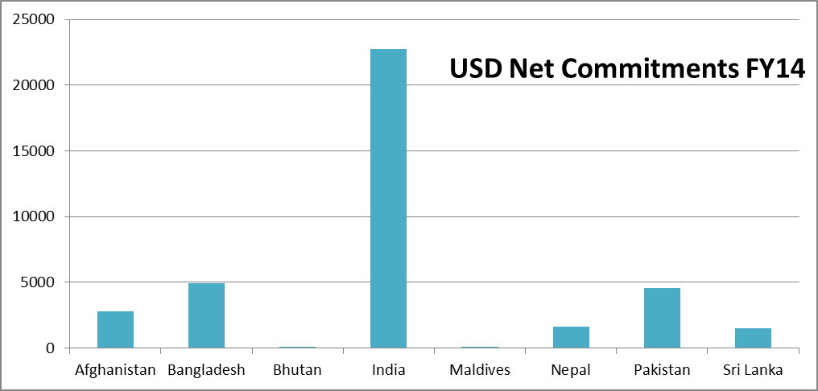
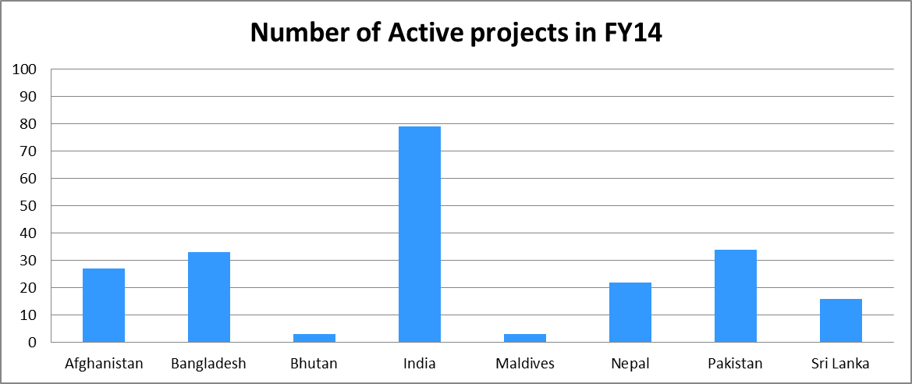
India represents 60% of the commitments, although 36 % of the projects

Slide 6
Stronger procurement systems
Suppliers registry
Framework agreements
E procurement
Training
Methods
Reverse auction
Certification
Capacity building
Procurement
Support
Auction theory analysis
Policies
Indicators
Records
Spend analysis
Contract management
Benchmarks
Systems
Processes and systems
Standardization
Information flows
Capacity building
Indicators

Slide 7
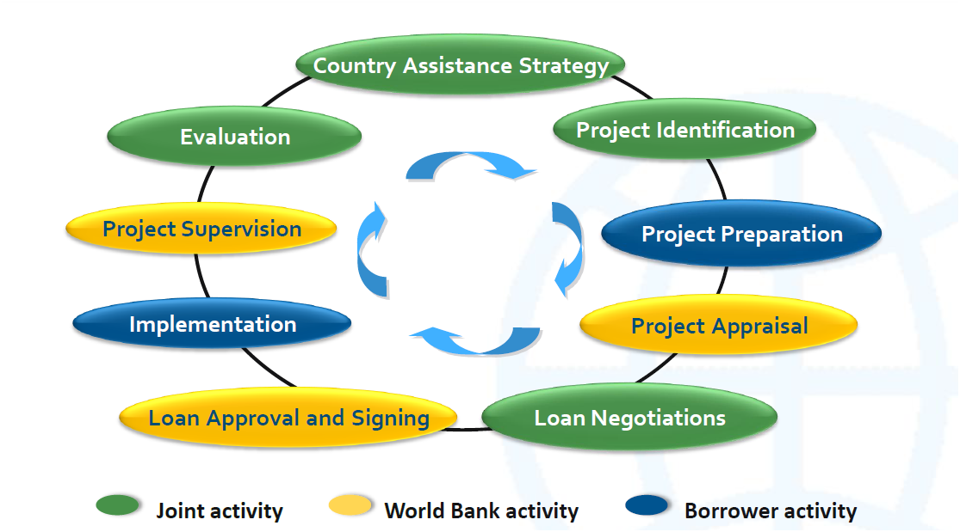
Investment Project Cycle

Slide 8
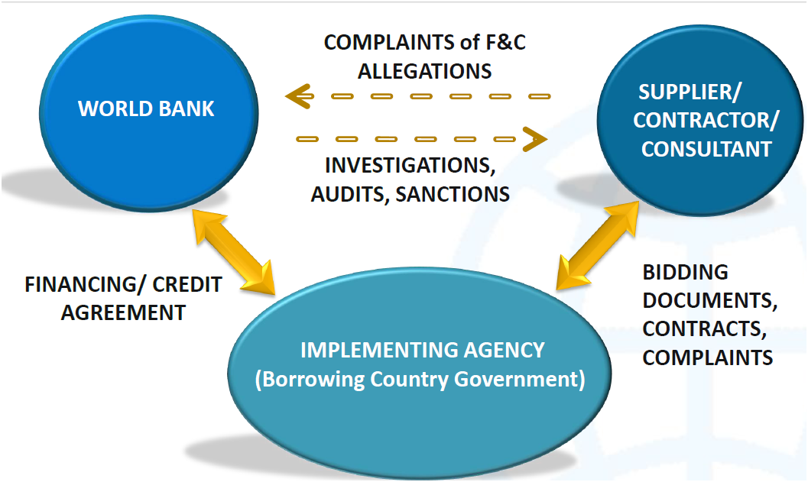
Role and Relationships

Slide 9
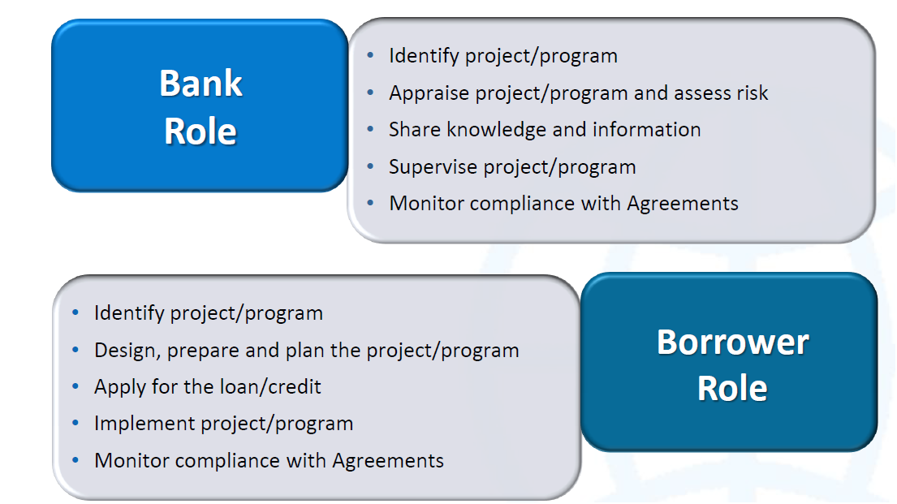
Roles in Bank- Funded Projects

Slide 10
What is Bank Procurement ?

Slide 11
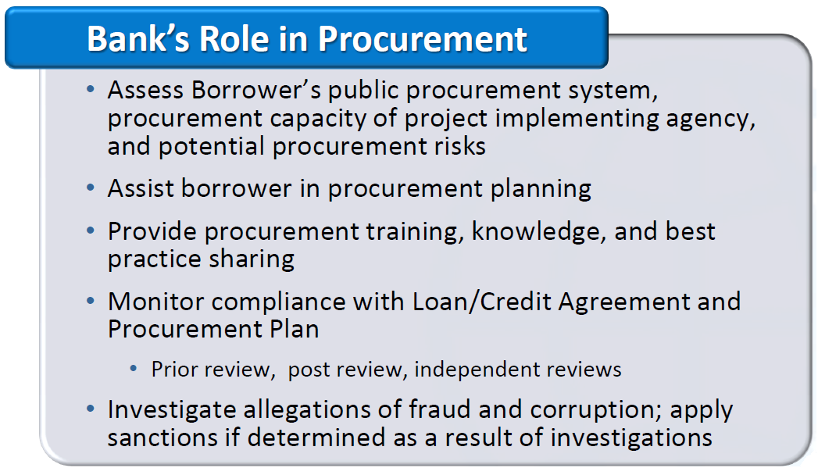
The Bank’s Role in Procurement

Slide 12
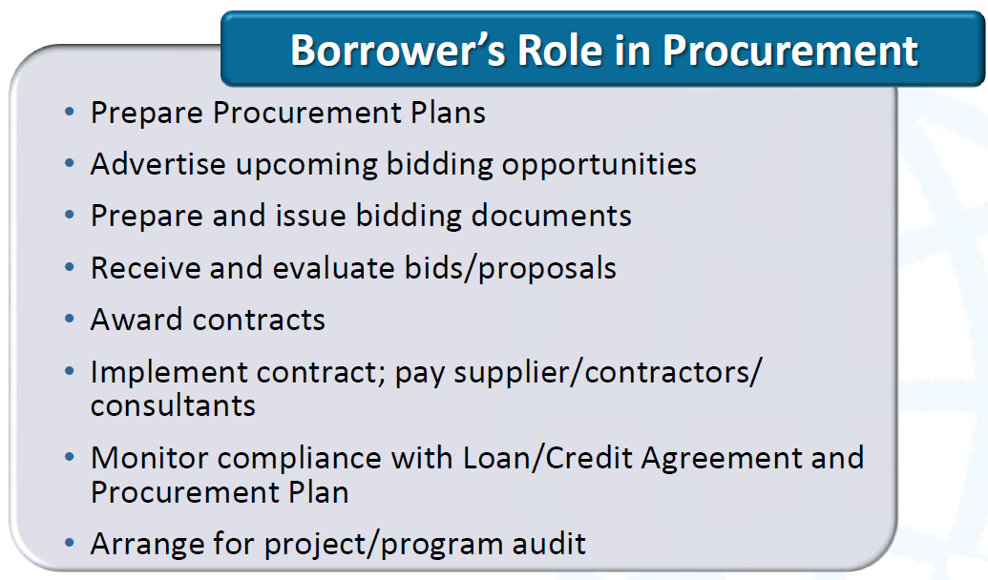
Borrower’s Role in Procurement

Slide 13
Considerations That Guide World Bank Procurement Policies
Principles
Efficiency
Economy
Equal Opportunity to Compete
Development of Local Industry
Transparency

Slide 14
Considerations That Guide World Bank Procurement Policies
What do you mean by ECONOMY ? Achieving ECONOMY is getting the right thing at the right price. VALUE FOR MONEY (VfM)
What is Efficiency? With ECONOMY in price and choice of item, ensuring its arrival in the RIGHT TIME and RIGHT PLACE for its intended use is EFFICIENCY

Slide 15
Considerations That Guide World Bank Procurement Policies
Transparency? is letting everyone know not only facts and figures of procurement, but also mechanisms and processes followed Right to Information
Equal Opportunity and Fairness? Demonstrating impartial, unbiased, and equitable treatment. …is conforming with rules and standards, free from discrimination and dishonesty

Slide 16
Considerations That Guide World Bank Procurement Policies
Bank’s interest as a co-operative institution in giving all eligible bidders from developed and developing countries an opportunity to compete
Bank’s interest as a development institution in encouraging the development of domestic contracting and manufacturing industries as well as Consulting Services

Slide 17
Introduction
The Articles of agreement require the World Bank to ensure that the proceeds of Loan/Credit are used for the purposes intended with due attention to economy and efficiency.
Accordingly, Bank has developed Guidelines (i) for procurement of Goods, Works, and (ii) Selection of Consultancy Services. Bank Guidelines explain the various procedures acceptable and these are applicable only to the extent provided in the Legal Agreements for specific projects.
Procurement is an important aspect of Bank’s operation. It is a critical element in Project Implementation and unless it is carried out efficiently and promptly, the full benefits of the Project cannot be realized.

Slide 18
Introduction….
Bank loans/credits are normally disbursed as expenditures are incurred. Since delays in procurement delays disbursements, every effort should be made to ensure prompt handling of procurement.
Good procurement practices alone cannot assure that the Bank assisted projects will achieve their development goals. But poor procurement practices virtually guarantee that these goals will not be fully achieved.
The responsibility for the execution of the Project and therefore for the award and administration of the contracts under the Project rests with the CLIENT/ PROJECT

Slide 19
Hierarchy of legal documents governing Bank operational procurement
WB’s country members
Articles of Agreement
WB
Procurement & Consultant Guidelines
General Conditions for IBRD Loans
General Conditions for Credits and Grants
WB & Borrowing Country
Loan Agreement
Loan Agreement
Credit Agreement

Slide 20
Bank’s Preference
Open Competition is the basis of efficient Public Procurement.
Borrowers to select appropriate Method for each Package and discuss during appraisal.
ICB should be chosen where feasible/appropriate with domestic preference if applicable .
Procurement Plan should indicate the appropriate method chosen, package wise, for review by Bank.
The Reference to PP is reflected in legal agreements.

Slide 21
Procurement
Applicable Procurement Guidelines May 2004, updated Oct 2006 revised May 2010 (Latest Guidelines are January 2011)
Public Procurement
- Economy
- Efficiency
- Transparency
- Fairness

Slide 22
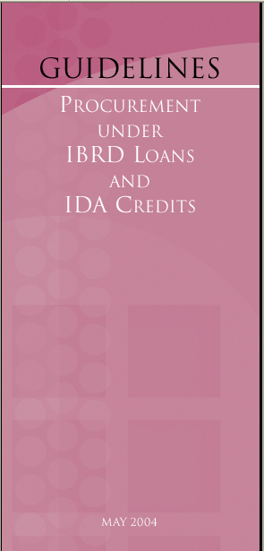
Procurement Guidelines
(May 2004, updated Oct 2006 revised May 2010)
Goods and Works & Non consulting services
Introduction
International Competitive Bidding
Other Methods
Appendices

Slide 23

Consultant Guidelines
(May 2004, updated Oct. 2006 revised May 2010 )
Consulting Services
Introduction
Quality- and Cost-Based Selection
Other Methods
Types of Contracts and Important Provisions
Selection of Individual Consultants
Appendices

Slide 24
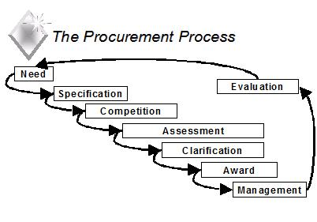
Procurement Process
The procurement process spans a life cycle from identification of the need, through the selection of suppliers, to post-contract award management, including disposal / complaint redressal
Notes:
Procurement does not merely refer to the simple purchase of goods, services or works, but the whole process, from “cradle to grave”, of acquiring goods, services or works. This process is referred to as the Procurement process.

Slide 25
Procurement Categories
Works
Goods
Service/NonConsultancy Services
The relative percentage of Works , Goods and Service/Non Consultancy Service may vary from project to project.
Notes:
Definition of Categories, Goods, Works and Services/Non Consultancy Services.

Slide 26
Procurement Methods
Shopping
NCB
ICB
Less Risk and Less Number of Procurement Opportunities per project/component
Fair/Open competition
High Lead time and Procurement cost

Slide 27
Procurement Relationship
Category | Name | Name
Goods | Purchaser | Supplier
Works | Employer | Contractor
Services | Client | Consultant
Non Consultancy Services | Client | Service Provider

Slide 28
TWO TYPES OF PROCUREMENT
GOODS AND WORKS. | CONSULTING SERVICES
PRODUCT BASED / DETAILED SPECIFICATIONS OPEN COMPETITION NO LIMIT ON THE NUMBER OF BIDDERS EVEN IN CASE OF PRE QUALIFICATION PRICE PLAYS AN VERY IMPORTANT ROLE IN BID EVALAUTION PUBLIC OPENING OF BIDS SINGLE STAGE PROCEDURE NORMALLY | KNOWLEDGE BASED / TERMS OF REFERENCE (GENERAL WORK PROGRAM) SHORTLISTS (6) PRICE PLAYS RELATIVELY A MINOR ROLE AND DEPENDING ON THE SELECTION METHOD NON-PUBLIC OPENING OF TECHNICAL PROPOSAL PUBLIC OPENING OF FINANCIAL PROPOSALS TWO-STAGE PROCEDURE

Slide 29
TWO TYPES OF PROCUREMENT
GOODS AND WORKS. | CONSULTING SERVICES
NEGOTIATIONS ON AN EXCEPTIONAL BASIS CONTRACT MUST BE AWARDED TO LOWEST EVALUATED RESPONSIVE BIDDER MEASURABLE PHYSICAL OUTPUT | NEGOTIATIONS NORMAL AND STARTING WITH THE TOP RANKED FIRM CONTRACT AWARD IS SUBJECT TO COMPLETING CONTRACT NEGOTIATIONS WITH TOP RANKED FIRM MOSTLY INTELLECTUAL OUTPUT (DIFFICULT TO MEASURE)

Slide 30
Standard Bidding Documents and Standard Requests for Proposals (SRFP)
Bank has developed standard bidding documents. These are based on Bank’s experience over the years.
Goods – Textbooks, Health Sector Goods (Pharmaceutical, vaccines)
Works – Small / Large
Prequalification document for Works
Consultancy Services
Supply and Installation
Information Systems
Non consultancy services – Performance of a Measurable Output - Mapping, Drilling etc
www.worldbank.org/procure

Slide 31
Applicability of Guidelines
The procedures outlined in these Guidelines apply to all contracts for goods and works financed in whole or in part from Bank loans. For the procurement of those contracts for goods and works not financed from a Bank loan, the Borrower may adopt other procedures.
In such cases the Bank shall be satisfied that the procedures to be used will fulfill the Borrower’s obligations to cause the project to be carried out diligently and efficiently, and that the goods and works to be procured:
(a) are of satisfactory quality and are compatible with the balance of the project;
(b) will be delivered or completed in timely fashion; and
are priced so as not to affect adversely the economic and financial viability of the project.
This includes those cases where the Borrower employs a procurement agent under para. 3.10.

Slide 32
Eligibility
Bank permits firms and individuals from all countries to offer goods, works, and non-consulting services.
Exceptions:
Exclude firms if Borrower’s country prohibits commercial relations with the country where Goods are manufactured.
By an act of compliance with a decision of the United Nations Security Council, the Borrower’s country prohibits any import of goods from, or payments to, a particular country, person, or entity.
Government-owned enterprises may participate only if they can establish that they (i) are legally and financially autonomous, (ii) operate under commercial law, and (iii) are not dependent agencies of the Borrower or Sub-Borrower .
A firm sanctioned by the Bank.

Slide 33
Different Methods of Procurement Methods
International Competitive Bidding (ICB)
Limited International Competitive Bidding (LIB)
National Competitive Bidding (NCB)
Shopping
Direct Contract (DC)
Force Account

Slide 34
Different Methods of Selection Process
Quality Cum Cost Based Selection (QCBS)
Quality Based Selection (QBS)
Least Cost Selection (LCS)
Fixed Budget Selection (FBS)
Consultant's Qualification Method (CQS)
Sole Source Selection (SSS)
Individual Consultants (IC)

Slide 35
PROCUREMENT Cycle
Completion
GPN
Contract Management
SPN
Contract Notification
Bidding
Evaluation
Opening
Discuss few aspects of ‘Procurement Plan’

Slide 36
Goods/Works Procurement Cycle
General Procurement Notice
Contract Performance
Adv. for PQ
Contract Signing
Prequalification
Issuing Bid Documents
Notification of Award
Pre-Bid Conference
Bid Evaluation
Bid Opening

Slide 37
Consultant Selection Cycle
General Procurement Notice
Contract Performance
Adv. for EOI
Contract Award
Short-listing
Issuing RFP Documents
Financial Proposal opening & Evaluation
Pre-proposal Conference
Tech. Evaluation
Tech. Proposal Opening

Slide 38
Request for Proposal (RFP)
Bank’s Standard Request For Proposals (SRFP)
Contents
Letter of Invitation
Information to Consultants – Data Sheet
Standard form for submitting Technical Proposals
Standard form for submitting Financial proposals
Terms of Reference
Standard form of Contract
Information on Financial negotiations

Slide 39
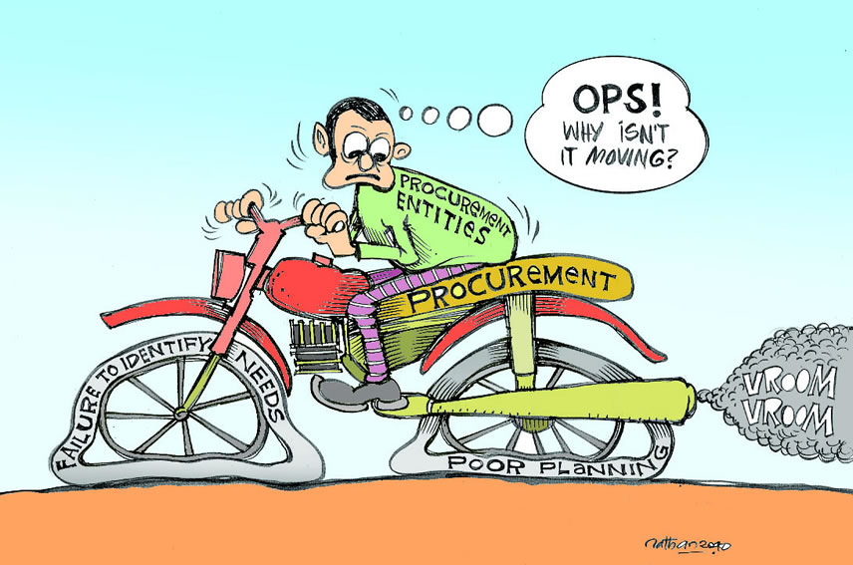
Consequence of Poor Procurement Planning

Slide 40
PROCUREMENT PLAN
Procurement Plan should be prepared separately for:
Goods
Works
Non consulting services
Consulting Services
The procurement Plan should take into account the procurement strategy, and various factors like:
Size of the contracts taking into account availability of qualified suppliers/contractors and their capacity;
Packaging of contracts for similar goods and works;
Appropriate methods of procurement for goods & works (ICB, NCB, Shopping etc.) and consulting services (QCBS, CQS, LCS, Individual Consultants, etc.)

Slide 41
PROCUREMENT PLAN
Procurement Plan should indicate the method, review by Bank (Prior / Post).
Methods of procurement to be adopted as well as review by Bank will be decided based on the total value of a Tender rather than on the value of each individual contract / schedule / lot / slice.
Try to achieve economies of scale, by procuring items required during a period thru a single procurement process

Slide 42
PROCUREMENT PLAN
Summary of the Procurement Packages planned during the first 18 months [List the Packages which require Bank’s prior review first and then the other packages]
Ref No. | Description | Estimated Cost US$ million | Packages | Domestic Preference (yes/no) | Review by Bank (Prior / Post)
 | Summary of the ICB (Works) | 82 | 5 | No | Prior
 | Summary of the ICB (Goods) | 43.77 | 15 | No | Prior
 | Summary of the NCB (Works) | 64.53 | 18 | No | Post
 | Summary of the NCB (Goods) | 1.86 | 4 | No | Post
 | Summary of the ICB (Non-Consultant Services) | 0.45 | 1 | No | Prior

Slide 43
GOODS/WORKS
 | ICB | NCB | Shopping | Force Account/ Direct
Works, Supply & Installation | > 40 Million USD | 100,000 to <=40 Million | Up to USD 100,000 | As per guidelines 3.8 with prior agreement of the Bank
Goods IT equipment and Non-consulting services | > 3,000,000 USD | < 3,000,000 & > 100,000 | Up to 100,000 USD | Direct Contracting 3.6 of the guideline with prior agreement of the Bank

Slide 44
Consultant Selection
QCBS | QBS/FBS/LCS | CQS | Single Source
Default method | Able to meet the provisions of the guidelines | < 200,000 USD | Justification in line with guidelines
Individual Consultants

Slide 45
Prior Review Threshold for Procurement of Works, Goods and IT System
Procurement Method | Prior Review Threshold | Prior Review by CPMU at CWC | Remarks
Goods, IT Systems and Non Consulting Services | >= US$ 500,000 | US$ 200,000 <= contracts < US $ 500,000 | In addition first contract respective of the value for both ICB and NCB for goods, IT Systems and Non Consulting Services will be subject to Prior Review by the Bank for each implementing agency
Works, Supply & Installation | >= US$ 5,000,000 | US$ 100,000 <= contracts < US $ 5,000,000 | In addition first contract respective of the value for both ICB and NCB for goods for Works and Supply & Installation will be subject to Prior Review by the Bank for each implementing agency
Direct Contracting | All contracts wherein the estimate is less than USD 10,000 | NIL
Force Account | All contracts irrespective of value | NIL

Slide 46
Prior Review Threshold for Procurement of Consultancies
Selection Method | Prior Review Threshold | Prior Review by CPMU at CWC | Remarks
Competitive Methods (Firms] | >= US$ 200,000 | >US$ 50,000 and < US $ 100,000 | In addition first contract respective of the value for each method of section [QCBS Time based, QCBS-Lump sum, QBS, FBS and Least Cost to be prior reviewed by the Bank for each implementing agency
Single Source | All | NIL | All single source contracts shall be subject to prior review by the Bank except when estimate is less than USD 10,000
Individual Consultants | > US $ 100,000 | >US $ 10,000 and < US $ 20,000

Slide 47


Slide 48
THANK YOU

